Slide 1
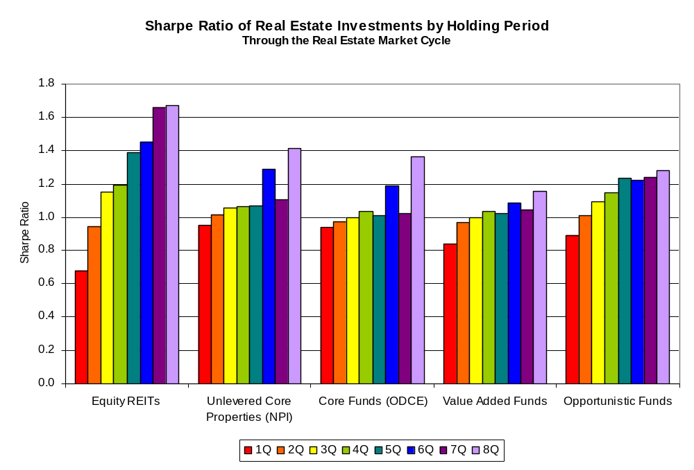
Publicly Traded Equity REITs Provide Better Risk-Adjusted Net Returns than Private Equity Real Estate Funds
Note: Data are for the full real estate market cycle, peak to peak: 1989Q3-2007Q1 for publicly traded REITs; 1990Q3-2008Q2 for unlevered core properties and core funds; 1990Q3-2008Q1 for value-added funds; and 1990Q3-2007Q4 for opportunistic funds. Fees and expenses are estimated at 115 bps for unlevered core properties and 50 bps for publicly traded REITs; net returns for private equity real estate funds are as shown in NCREIF ODCE (core funds) and NCREIF/Townsend Fund Indices (value added and opportunistic funds). Source: NAREIT analysis of data from NCREIF and from FTSE NAREIT Equity REITs Index.

